Slide 1
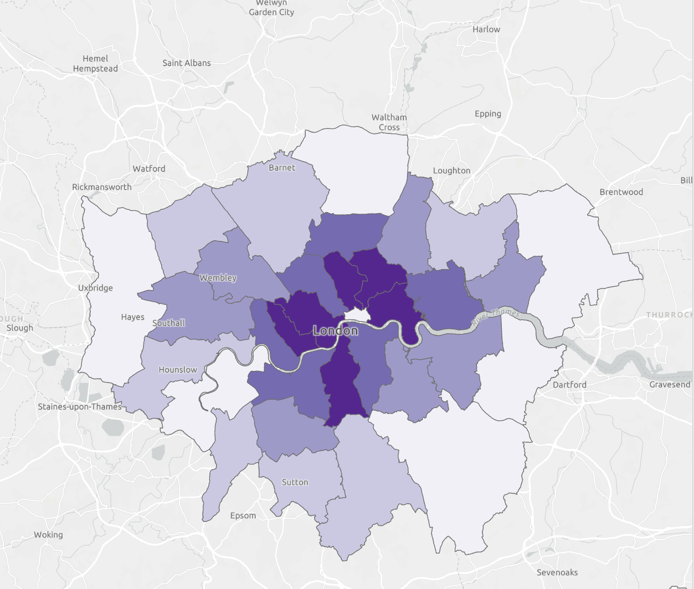
London Borough Population Density Per Square Kilometer

Slide 2
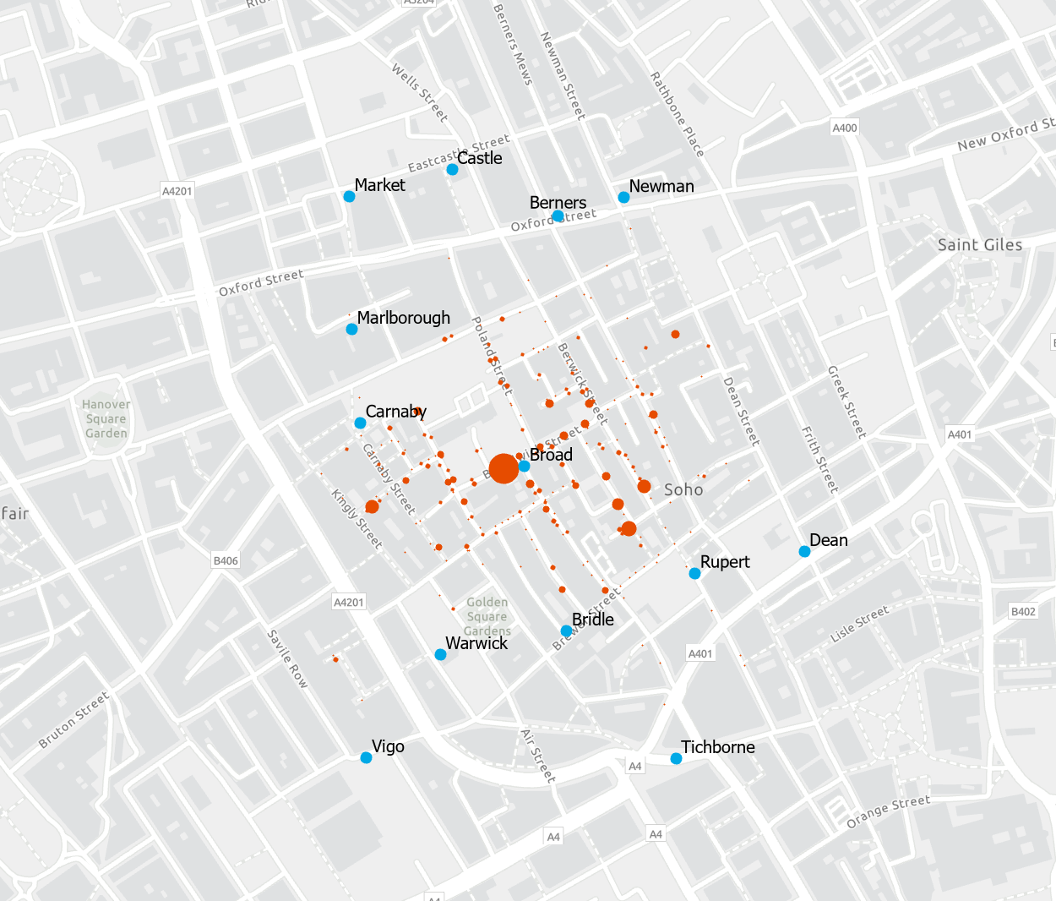
Number of Cholera Deaths by Address

Slide 3
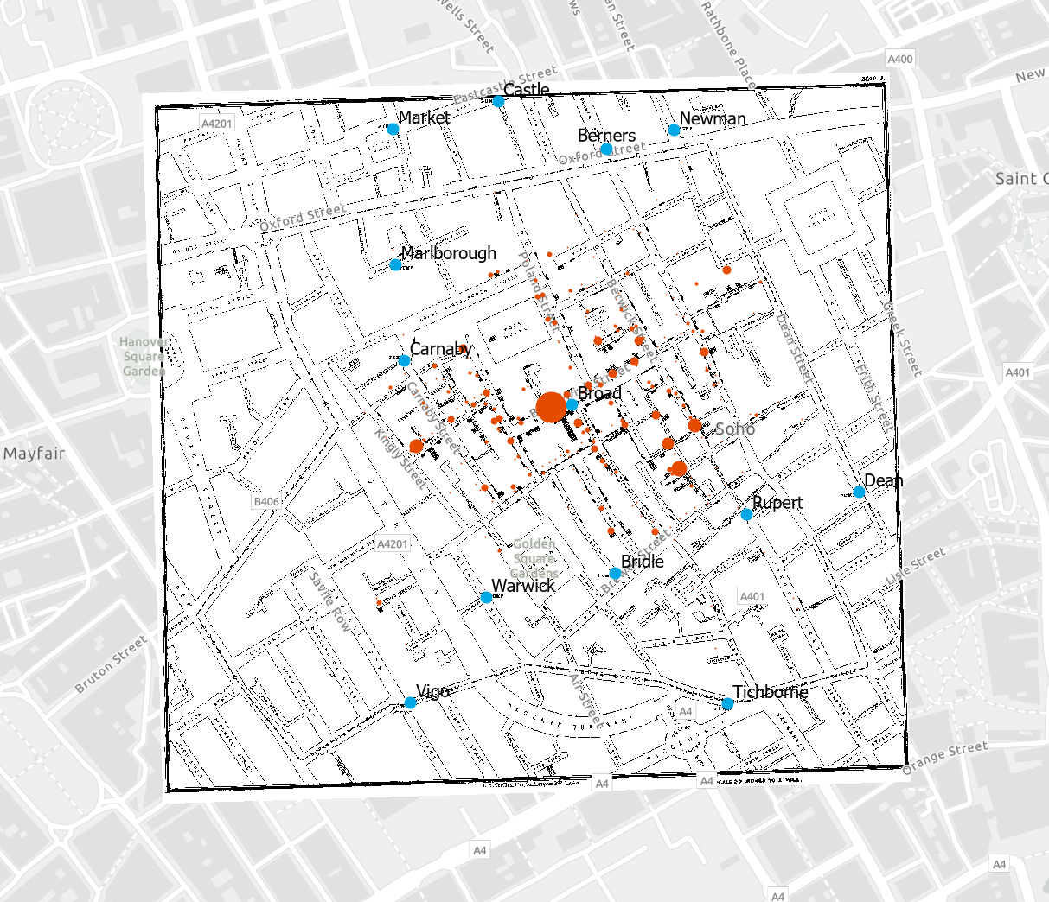
Number of Cholera Deaths by Address, John Snow Map

